Slide 1


Human Microbiome Epidemiology and Bioinformatics November 27, 2018
Levi Waldron

Slide 2
Background: Our Microbiota
All the people living in our United Netherlands are not as many as the living animals I carry in my own mouth this very day.
Antony van Leeuwenhoek, 1683
(provided first scientific descriptions of bacteria)
Notes:
So what’s the deal with the oral microbiota? We most often hear about the gut microbiota, but the oral microbiota is one of the most diverse bacterial communities on the human body and indeed the world. It’s arguably the first microbiome to be discovered, by Antony van Leeuwenhoek in 1683, who looked at his subgingival plaque under a very rudimentary microscope and guessed there were more bacteria in his mouth than people in Netherlands.
Image?

Slide 4
Study Through Culture
Limitations:
Laborious and non-quantitative
Only observes a few species at a time
Many bacteria are “unculturable”
Why bacteria can’t get any bigger—or smaller
Science Mag News, Elizabeth Pennisi Apr. 12, 2016

Slide 5
- genomic sequencing costs
Erika Check Hayden, Technology: The $1,000 genome. Nature News 2014.

Slide 6
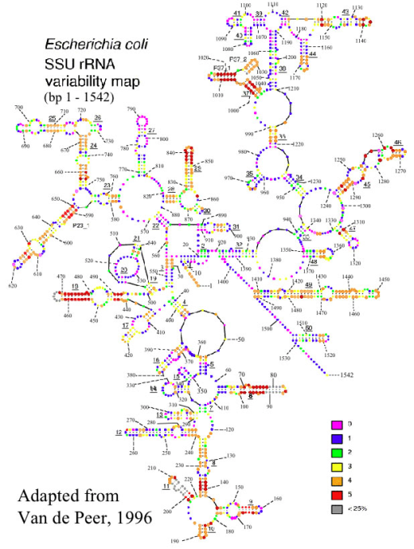

Sequencing as a Tool for Microbial Community Analysis
16S rRNA
sequencing
Whole-metagenome shotgun
sequencing
George Rice, Montana State University
Specific PCR primer to amplify the 16S rRNA marker gene
Random PCR primer
to amplify all DNA in a specimen
~$50 / sample
~$1000 / sample
6

Slide 7

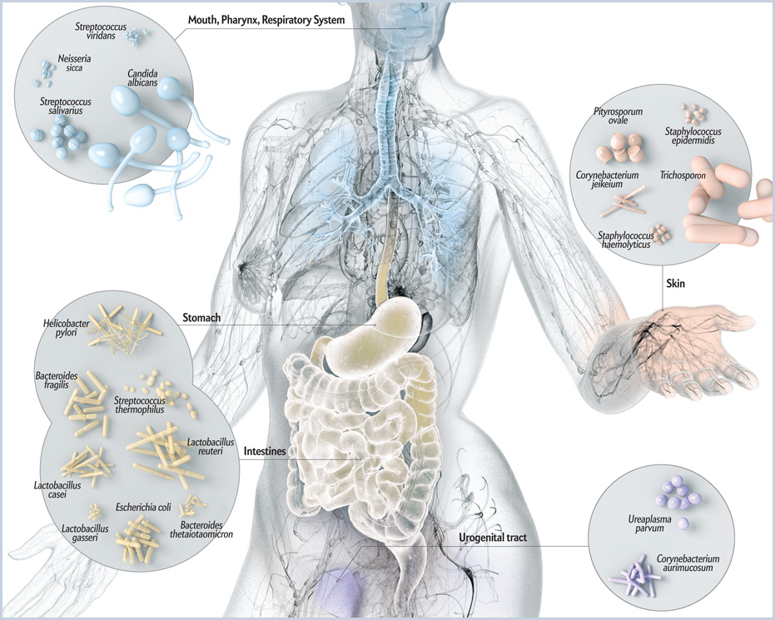
Microbial communities: in, on, outside us
10x more microbial than human cells
1M times as many microbes inside each of us than humans on earth
100x more microbial than human genes
Nature 486(7402)
Who’s there?
What are they doing?
Scientific American, May 2012
Metagenomics:
Study of uncultured microorganisms from the environment, which can include humans or other living hosts
Focus on taxonomic and functional characteristics of the total collection of microorganisms within a community
Main experimental tool is high-throughput sequencing: ~10M short (~100nt) reads per dataset
Illustration by Bryan Christie, http://www.scientificamerican.com

Slide 8
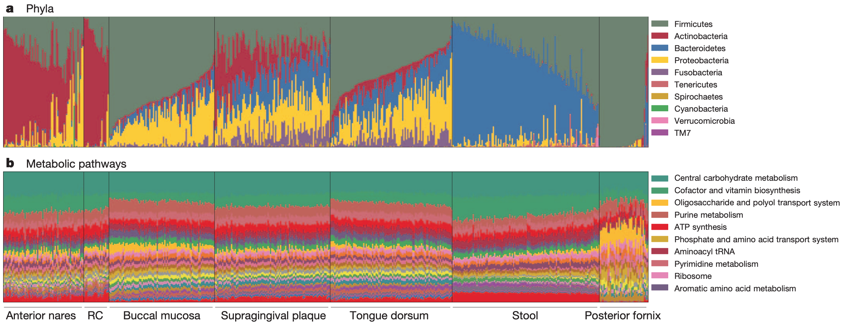
Structure and function of the healthy human microbiome
Who is there?
What are they doing?
Human Microbiome Project Consortium: Structure, function and diversity of the healthy human microbiome. Nature 2012, 486:207–214.

Slide 9
Roles of the human microbiome (a very abbreviated short-list)
A healthy microbiome is involved in:
immune function
protection against dangerous microbes
metabolism
But may contribute to:
Inflammatory Bowel Disease
Obesity
Cancer
Cho I, Blaser MJ: The human microbiome: at the interface of health and disease. Nat. Rev. Genet. 2012, 13:260–270.

Slide 10
WHAT ABOUT CUNY SPH? EPIDEMIOLOGY

Slide 11


NYC HANES is a population-representative sample of >3,500 non-institutionalized adults in New York City
Conducted by CUNY SPH and the NYC DOHMH
Lorna Thorpe & Sharon Perlman, PI
Oral microbiome component conceived by Prof Heidi Jones, CUNY SPH
Notes:
First of all I want to introduce NYCHANES which is a project started in 2013 and coordinated by two NY institutions, the CUNY School of public Health and the Department of Health and Mental Hygene. Pratically speaking It’s a large-scale survey made to assess the health status of adult new yorkers.

Slide 12
Exposures, outcomes, confounders
Exposures
Tobacco use
Age group
Gender
Family Income
Educational achievement
Race/ethnicity
Birthplace
Marital status
Confounders
Sugar-sweetened beverage consumption
Mouthwash use
Age and sex
Primary outcome
microbial abundances

Slide 13
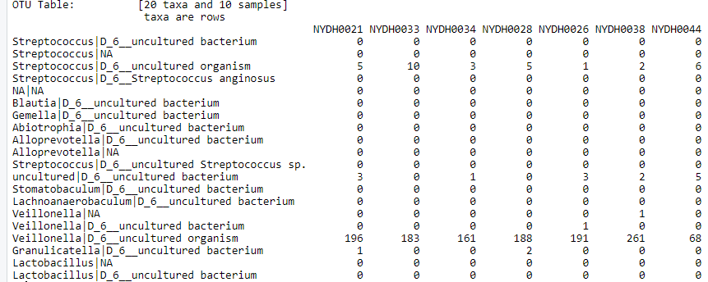
. . .
. . .
. . .
. . .
. . .
. . .
. . .
. . .
. . .
Operational Taxonomic Units (OTUs)
Participants
N=297 oral rinse samples underwent 16S rRNA sequencing
Bacterial taxa determined by clustering into Operational Taxonomic Units (OTUS)

Slide 14
Methods: Statistical Analysis
Differences in overall community structure
Weighted UniFrac distances
Principal Coordinate Analysis (PCoA)
Permutation multivariate ANOVA (PERMANOVA)
Differential abundance of OTUs
edgeR log-linear generalized linear models (GLMs)

Slide 15
Overall oral microbiome between smokers and non-smokers
Major shifts are related to microbial oxygen utilization
Beghini et al. : Tobacco exposure associated with oral microbiota oxygen utilization in the New York City Health and Nutrition Examination Study. bioRxiv 2018:470286.

Slide 16
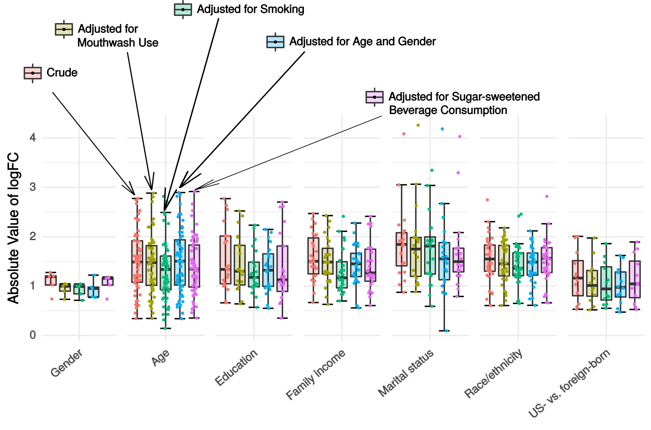
Sociodemographic results: Crude vs. adjusted models
Renson et al.: Sociodemographic patterning in the oral microbiome of a diverse sample of New Yorkers. bioRxiv 2017:189225.

Slide 17
WHAT ABOUT CUNY SPH? BIOINFORMATICS

Slide 18

Microbiome bioinformatics
at CUNY SPH
Bioconductor provides >1,000 packages for analysis of high-throughput genomic data
built on R environment
Rich resources for analysis of microbiome data
Pasolli E and Schiffer L et al.: Accessible, curated metagenomic data through ExperimentHub. Nat. Methods 2017, 14:1023–1024.
Schiffer L et al. : HMP16SData: Efficient Access to the Human Microbiome Project through Bioconductor. bioRxiv 2018:299115. (In Press at American Journal of Epidemiology)

Slide 19


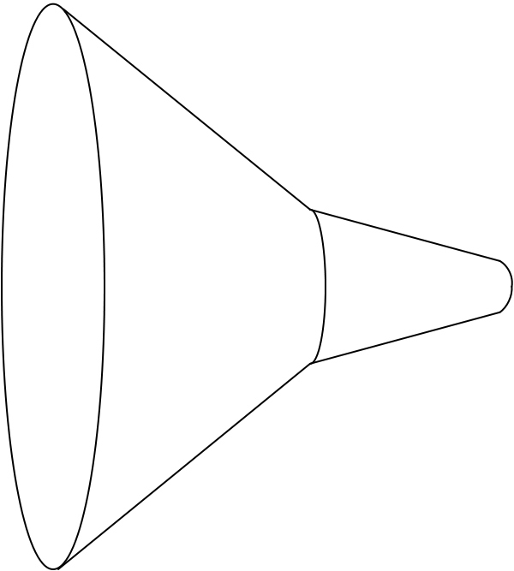
curatedMetagenomicData
Raw
fastq files
41 datasets
7,152 samples
Study metadata
Age, body site, disease, etc…
Differential abundance
Diversity metrics
Clustering
Machine learning
Convenience download functions
Megabytes-sized datasets
Download (~50TB)
ExperimentHub product
Amazon S3 cloud distribution
Tag-based searching
Dataset snapshot dates
Automatic local caching
Uniform processing
Manual curation
MetaPhlAn2
HUMAnN2
Automatic documentation
species abundance
metabolic pathway abundance
Integrated Bioconductor ExpressionSet objects
Per-patient microbiome data
Per-patient metadata
Experiment-wide metadata
marker
presence
metabolic pathway presence
standardized metadata
marker abundance
gene family abundance
60 kH CPU
75TB disk requirements
Integration
Pasolli E and Schiffer L et al.: Accessible, curated metagenomic data through ExperimentHub. Nat. Methods 2017, 14:1023–1024.

Slide 20
curatedMetagenomicData use
One dataset from R:
> curatedMetagenomicData("HMP_2012.metaphlan_bugs_list.stool”)
Many datasets from R:
> curatedMetagenomicData("HMP_2012.metaphlan_bugs_list.*”)
Command-line:
$ curatedMetagenomicData -p "HMP_2012.metaphlan_bugs_list.*"
Pasolli E and Schiffer L et al.: Accessible, curated metagenomic data through ExperimentHub. Nat. Methods 2017, 14:1023–1024.

Slide 21
Investigating “enterotypes” of the human gut microbiome
Credit:
Audrey Renson
Pasolli E and Schiffer L et al.: Accessible, curated metagenomic data through ExperimentHub. Nat. Methods 2017, 14:1023–1024.

Slide 22
Future work
Methods and resources for more systematic analysis of human microbiome studies
Curation of the literature on differentially abundant microbes and microbial properties
Expansion / analysis of curatedMetagenomicData

Slide 23
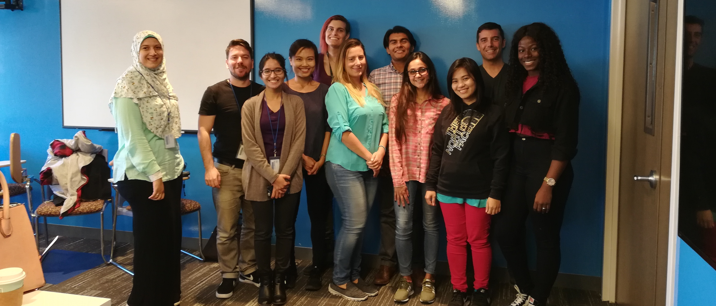
Thank you
http://waldronlab.io
Post-docs: Ludwig Geistlinger, Sehyun Oh
Developer: Marcel Ramos
PhD student: Chloe Mirzayi
MPH students: Shaimaa Elsafoury, Fatima Zohra, Marianthi Thomatos, Phyu Han
Research interns: Rimsha Azhar, Christina Brown
Collaborators:
Curtis Huttenhower (Harvard School of Public Health)
Nicola Segata lab (University of Trento Center for Integrative Biology)
Bioconductor Team: Martin Morgan, Vincent Carey, Kasper Hansen

